Slide 1
Getting started with git and github

Slide 2
Objectives
Requirements
Learn basics of version control with git
Cycle of work
Terminology
Commands
Learn basics of github
Remote repositories
Setting up keys
Sharing code
Collaborating with forks and pull requests
Level up
Github pages – portfolio for your code
Conflicts and merging
Starting over (if all else fails)
Software on your computer
Github Desktop
SourceTree (Atlassian)
Windows computers – do they have git on the terminal?
Going to the class repo at github.com (should be familiar with this)

Slide 3




Terminology: remote versus local repository
Github.com hosts git repositories
https://github.com/ Your-username/your-repo-name
e.g. https://github.com/Colorado-State-University-CMB/CM515-course-2024
Your local computer clones the remote repo
git clone https://github.com/ Your-username/your-repo-name
e.g. git clone https://github.com/Colorado-State-University-CMB/CM515-course-2024

Slide 4

Steps to working on a repo: step 0. Clone repo.
Clone Remote (1st step, done once)
New project → Clone existing repo
Downloads files
and git data
Downloads files
and git data
Creates new folder on your computer. Working tree (your files)
Creates new folder on your computer. Repository files are in “File ”tab in RStudio

Slide 5
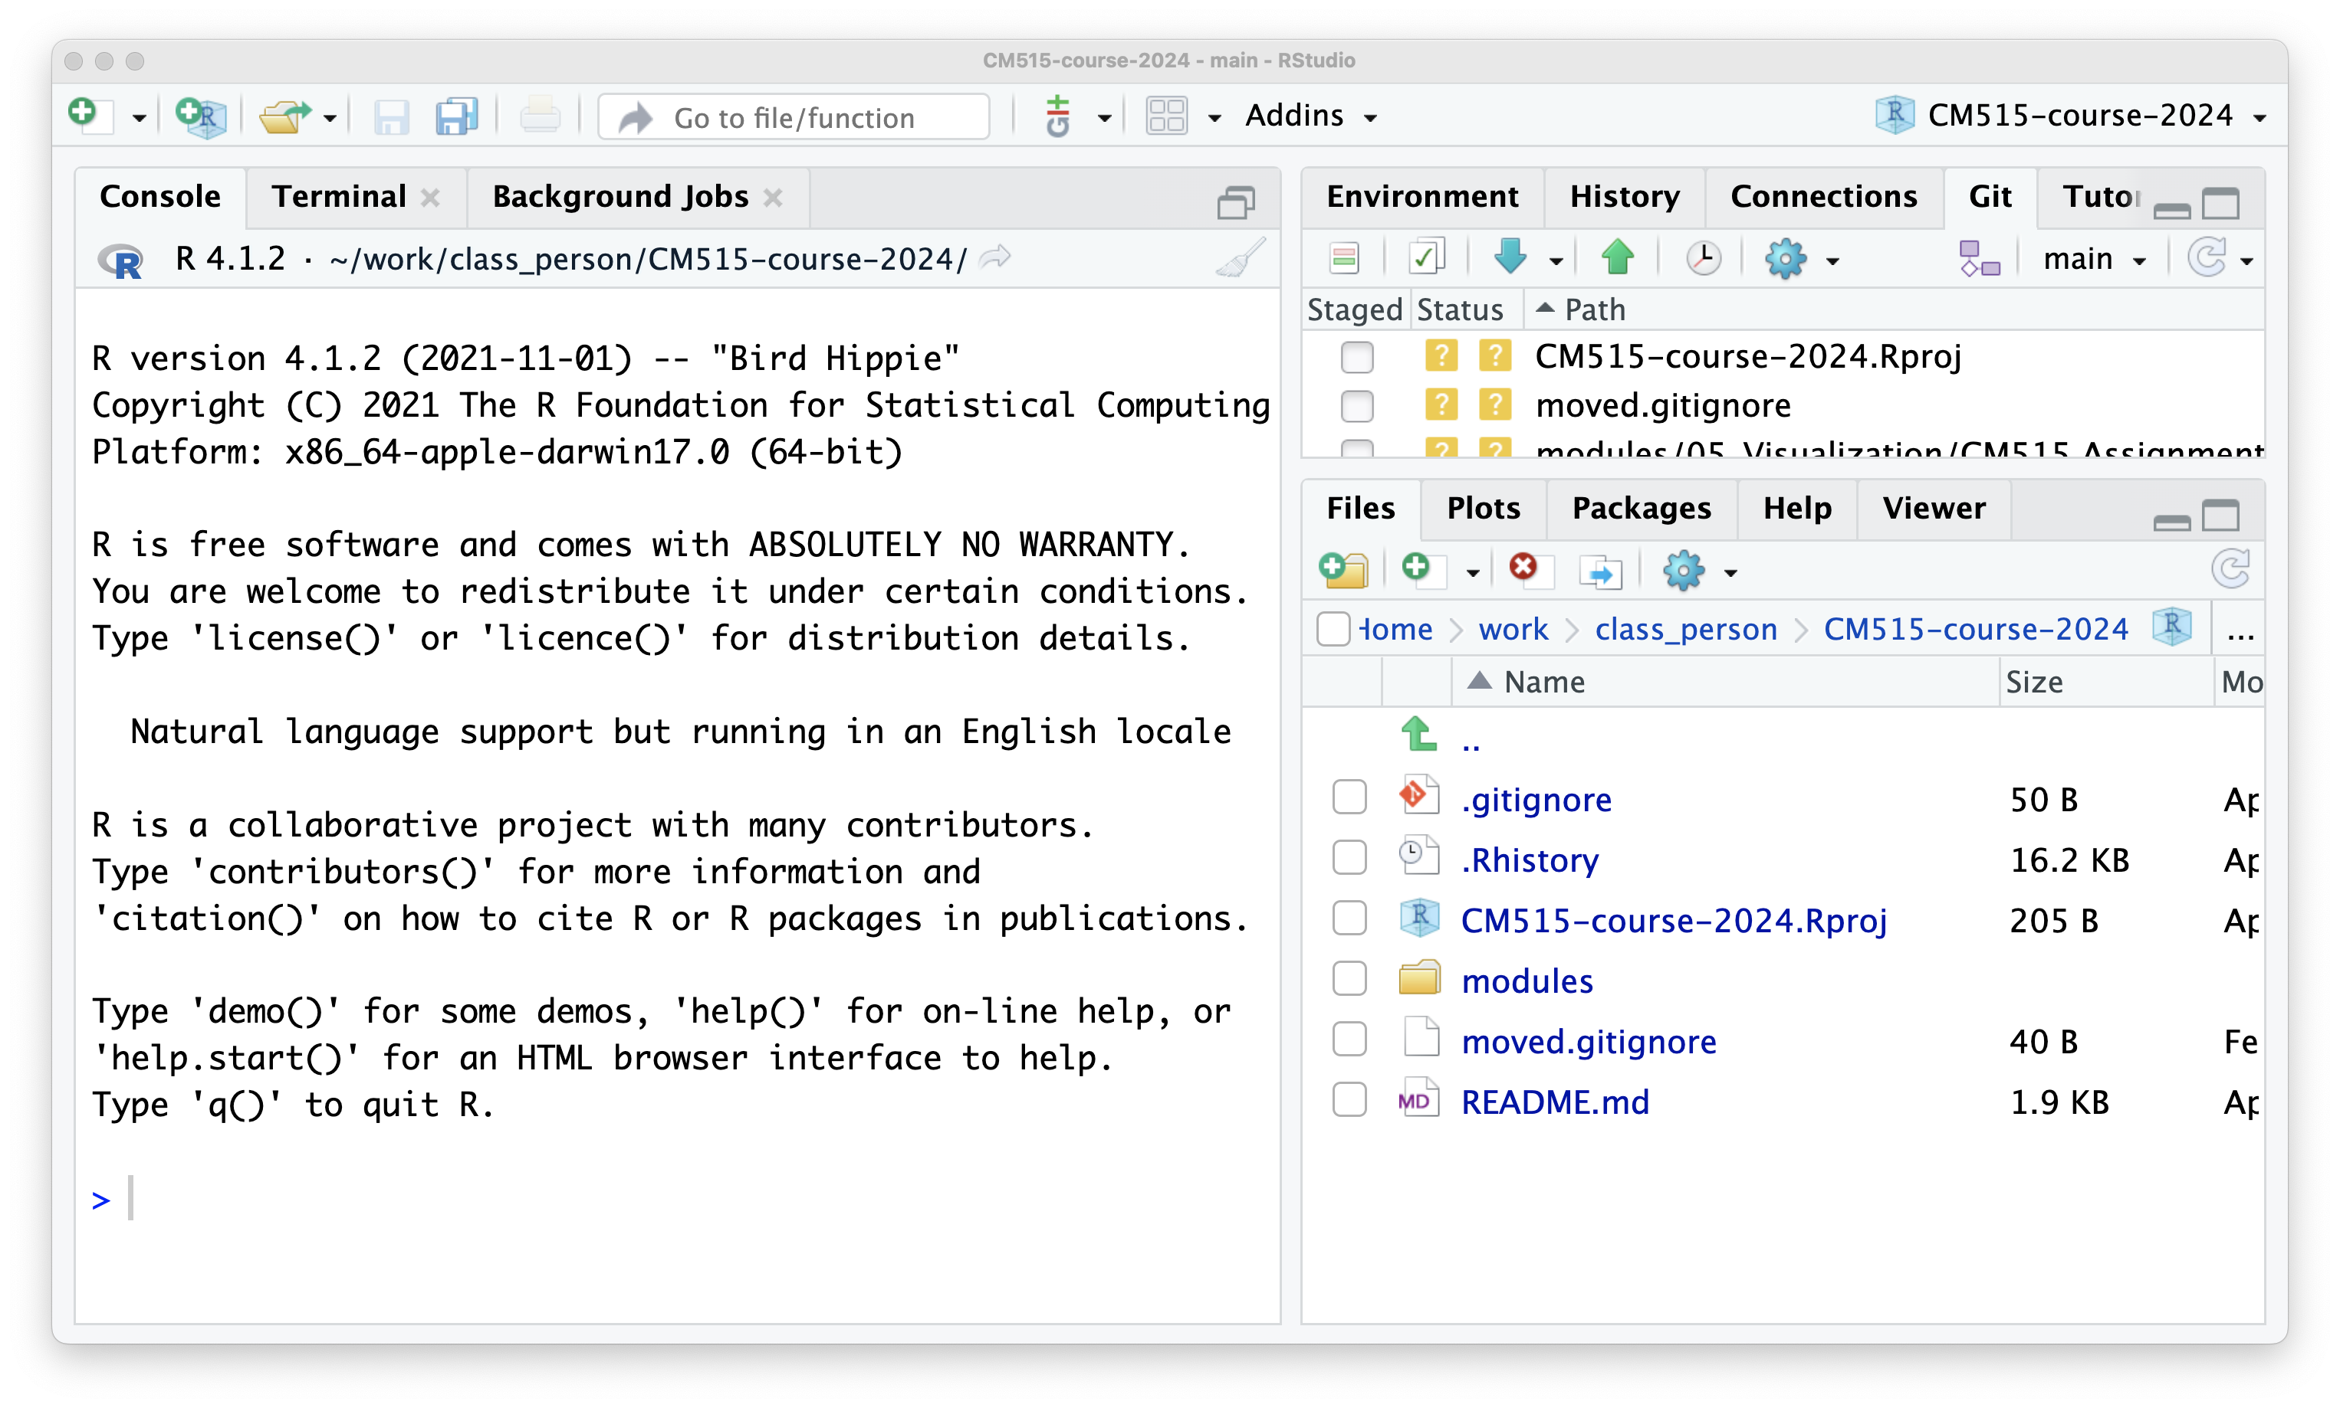
untracked file
(only on my computer)

Slide 6
Staying up-to-date with remote
Class week 1: ChatGPT
Class week 2: RStudio
Class week 3: Files and folders
Class week 4: Tidyverse
Clone repository
pull
pull
pull
Modules/
└── 01_chatGPT/
Modules/
├── 01_chatGPT/
└── 02_RStudio/
└── 02_240129_R_Basics.md/
Modules/
├── 01_chatGPT/
├── 02_RStudio/
│ └── 02_240129_R_Basics.md/
└── 03_Files_and_Folders/
Modules/
├── 01_chatGPT/
├── 02_RStudio/
│ └── 02_240129_R_Basics.md/
├── 03_Files_and_Folders/
└── 04_Tidyverse/

Slide 7
It’s OK to add your own files alongside the tracked ones.
Class week 1: ChatGPT
Class week 2: RStudio
Class week 3: Files and folders
Class week 4: Tidyverse
Clone repository
pull
pull
pull
Modules/
└── 01_chatGPT/
Modules/
├── 01_chatGPT/
└── 02_RStudio/
├── 02_240129_R_Basics.md
├── assignment1.html
└── knitted.html
Modules/
├── 01_chatGPT/
├── 02_RStudio/
│ ├── 02_240129_R_Basics.md
│ ├── assignment1.html
│ └── knitted.html
└── 03_Files_and_Folders/
└── assignment2.html
Modules/
├── 01_chatGPT/
├── 02_RStudio/
│ ├── 02_240129_R_Basics.md
│ ├── assignment1.html
│ └── knitted.html
├── 03_Files_and_Folders/
│ └── assignment2.html
└── 04_Tidyverse/
└── assignment3.html
- untracked, added by you

Slide 8
But modifying a tracked file causes a divergence from the repo
Class week 1: ChatGPT
Class week 2: RStudio
Class week 3: Files and folders
Class week 4: Tidyverse
You can usually still pull if the repo only adds/changes other files
Clone repository
pull
pull
Modules/
└── 01_chatGPT/
Modules/
├── 01_chatGPT/
└── 02_RStudio/
├── 02_240129_R_Basics.md
├── assignment1.html
└── knitted.html
Modules/
├── 01_chatGPT/
├── 02_RStudio/
│ ├── 02_240129_R_Basics.md
│ ├── assignment1.html
│ └── knitted.html
└── 03_Files_and_Folders/
└── assignment2.html
Modules/
├── 01_chatGPT/
├── 02_RStudio/
│ ├── 02_240129_R_Basics.md
│ ├── assignment1.html
│ └── knitted.html
├── 03_Files_and_Folders/
│ └── assignment2.html
└── 04_Tidyverse/
└── assignment3.html
- untracked , added by you
- Modified, changed by you

Slide 9
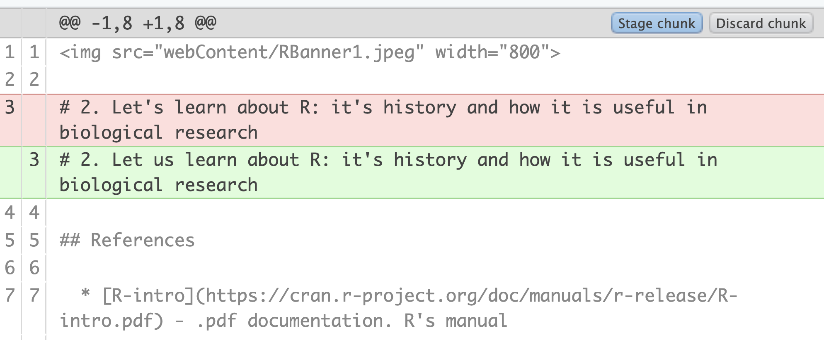
Using Git with RStudio (1)
We will use RStudio’s “git” tab to track the changes we make to the repository
Find the right windows, tabs and files
Go to the File tab and navigate to modules/02_RStudio.
Click on 02_240129_R_Basics.Rmd to open it in the editor.
Click on the “git” tab in the upper right.
Make a change to the tracked file
Modify 02_240129_R_Basics.Rmd and save it. I changed “let’s” to “let us”.
Notice the “modified” status appear.
“Diff”
Select the file and click “diff” on the left side of the window.
See the difference between your working copy and the repository.

Slide 10
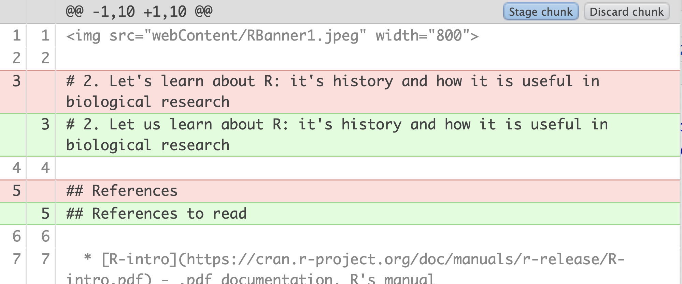
Using Git with RStudio (2)
We will use RStudio’s “git” tab to track the changes we make to the repository
Make another change and save it.
I changed “References” on line 5 to “References to read”
Now two lines are diff’d.

Slide 11
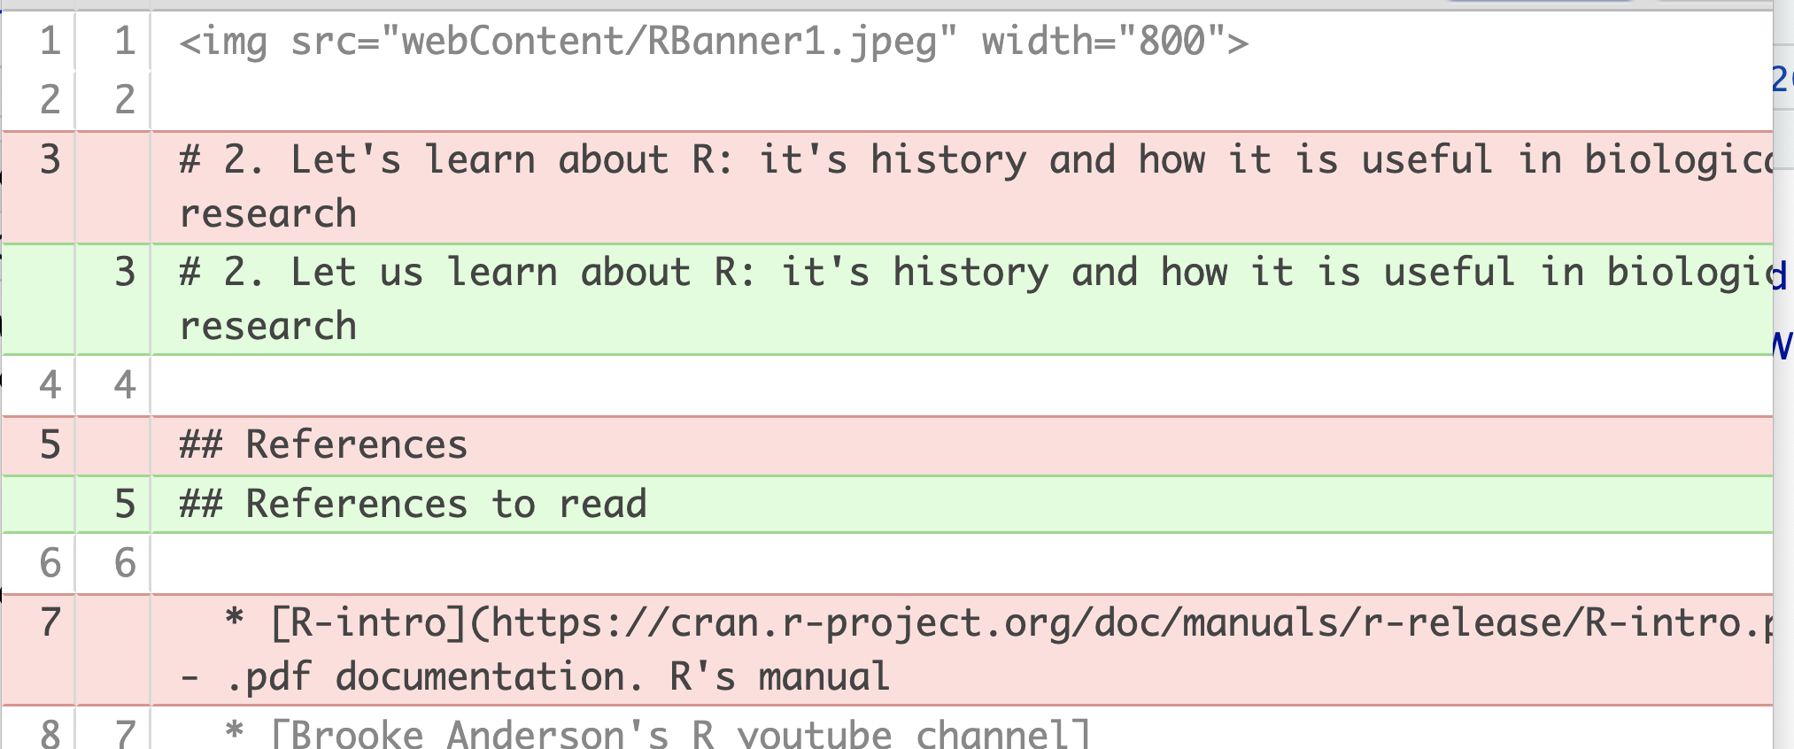
Git/RStudio (3)
We will use RStudio’s “git” tab to track the changes we make to the repository
I deleted the R-intro reference, line 7.
Now the line numbers are different
Repo – still contains line 7.
Working tree– line 7 is now the reference to Brooke’s youtube channel.

Slide 12
Git/RStudio (4) Reverting your changes, safely
You can revert to the repository’s version of a file
But it overwrites your changes
So, use with caution- make a copy first
Exercise
Make a copy of 02_240129_R_Basics.Rmd by checking the box next to the filename and go to the “gear” icon to copy it.
Then, in the Git tab, click box by the modified file, click the gear icon and choose “Revert”
Confirm in the dialog box.

Slide 13
Git/RStudio (5) Resolving conflicts
They make a change to a file in the current module
I change the same file on the repo
They try to pull, generating the error message
They copy their modified copy and revert the file, then pull
The conflict should be resolved

Slide 14
Using an App with Git
Github desktop
SourceTree (Atlassian)– shows graph of branches
Other IDEs, such as VS Code, RStudio, etc., that highlight status of files in repo and commit/push/pull

